Slide 1
Lake Carnico Creel Survey, 2022
From April 1 though October 31 a roving creel survey was conducted on Lake Carnico.
In total, 710 Fishing trips were recorded (6.3 Trips per acre), 2,465 hours spent fishing.
This trips per acre is less than several of the smaller lakes we manage, but on par with the pressure we see on some of our bigger lakes.
Most of the anglers were male (92%), Kentucky Residents (96%) and were fishing from a boat (68%)

Slide 2
Lake Carnico Creel Survey, 2022
During the survey 1,508 fish were caught, and only 123 fish harvested.
Most of the fish caught were Largemouth bass.
No Largemouth Bass were harvested from the lake.
Largemouth Bass - best months were July, August and September.

Slide 3
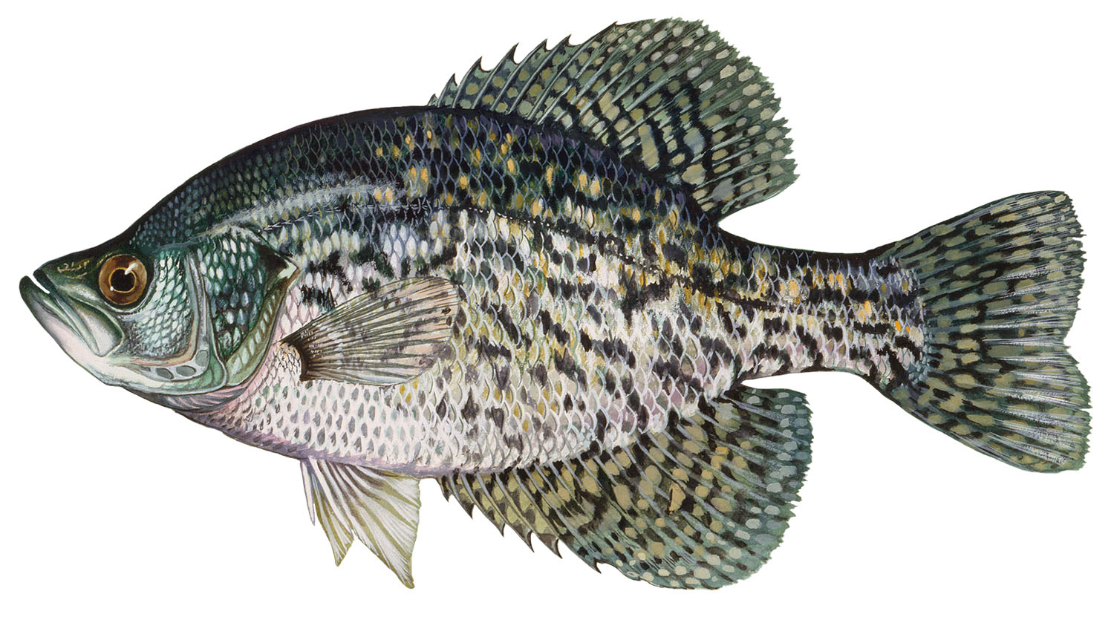
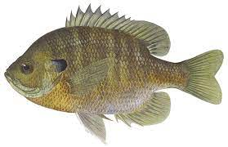
Lake Carnico Creel Survey, 2022
About 50% of the crappie caught were harvested.
Mean length of White Crappie was 12 inches and mean length of Black Crappie was 10 inches.
May was the best overall month for crappie angling.
Majority of the panfish caught were Bluegill (99%)
About 21% of those caught were harvest and the mean length of those harvest was 5 inches.

Slide 4
Lake Carnico Creel Survey, 2022
ANGLER ATTITUDE SURVEY
Surveyed 278 people in total
Not all of these answered every question.
Done in conjunction with the creel survey.
Our opportunity to ask anglers directly questions.
Roughly 12 questions with follow-ups dependent on their responses.
Pretty evenly split in anglers frequency or experiences on Lake Carnico.
Was surprised on the number of Non-NCDC anglers we surveyed.

Slide 5
Lake Carnico Creel Survey, 2022
Angler attitudes….
Generally favorable with bass anglers (N=167), crappie anglers (N=45), catfish anglers (N=38) and Sunfish anglers (N=17)
BASS ANGLERS
CRAPPIE ANGLERS
CATFISH ANGLERS
SUNFISH ANGLERS

Slide 6
Lake Carnico Creel Survey, 2022
Size limit on Bass…
Vegetation on Lake Carnico…
“Should the Largemouth Bass size limit be changed to a 12” minimum size limit?”
N=265
“Over the last 3 years do you feel like the vegetation issues at Lake Carnico are…”
N= 206

Slide 7
Vegetation Plan for 2023
600 more grass carp have been ordered
These fish DO make a difference, it’s just not overnight
Spraying will continue in 2023
Mixture of Diquat and Cutrine is effective
We are going to be more aggressive with it in 2023
We cannot directly spray around private docks
Reminder: Residents cannot treat the vegetation themselves
Kentucky Dept. of Agriculture rule
Consultants can help around private docks
I have a consultant list… just contact me if you’d like a copy
A few random thoughts…
This spring has been aggressive. Don’t judge the whole year on the early growth
Silk algae, Spirogyra, early grower. Should die back in June or so
Fragmentation- parts of the plant act as seeds
Pulling or cutting is NOT a good idea

